Slide 1
OpenFlow Router

Slide 2
Switch-Centric Topology
OvS
DCN
OvS
192.168.s0.0/27
SAM
Server0
OvS
OvS
OvS
OvS
10.1.1.2
Kernel
192.168.s2.0/27
VNF1
BESS
OvS
OvS
OvS
OvS
Classifier
Server2
DCN
Gateway 1
DCN
Gateway 2
Server4
Kernel
192.168.s4.0/27
192.168.s3.0/27
Kernel
192.168.s1.0/27
10.1.1.1
Classifier
Web
Server 1
Web
Server 2
Ingress
Server1
VNF1
BESS
Inbound traffic = 2.2.2.2 -> 1.1.1.1
Website DNS IP = 1.1.1.1
Server3
Kernel

Slide 3
IP Addressing
Each switch could connect several servers and other switches.
Each switch (which connected with servers) is assign an gateway address: 192.168.[switchID.1].
[switchID] takes up 11 bits, the lower 5 bits is host number.
This addressing support 2048 switches, each switches support 30 servers.
This ip addressing can used to implement fat-tree k=36 (1620 switches and 11664 servers)

Slide 4
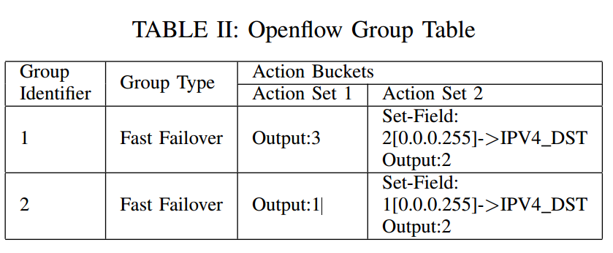
Switch’s Tables
Flow Table 2 – WEST_EAST_TABLE
Match | Action | Priority
dstIP=192.168.[switchID.1].0/27 | Outport 1, TTL, srcdstmac | 1
dstIP=192.168.[switchID.2].0/27 | Outport 2, TTL, srcdstmac | 1
Table-miss | PACKET_IN | 0
Flow Table 0 – MAIN_TABLE
Match | Action | Priority
dstIP=192.168.[switchID.0]/27 | Table 1 | 3
dstIP=192.168.0.0/16 | Table 2 | 2
dstIP=10.0.0.0/8 | Table 3 | 2
etherType=IPv4 | Outport X | 0
Table-miss | PACKET_IN | 0
Flow Table 3 – UFFR_TABLE
Match | Action | Priority
dstIP=10.1.1.0 | Group 1 | 1
dstIP=10.1.2.0 | Group 2 | 1
Table-miss | PACKET_IN | 0
Flow Table 1 – LAN_TABLE
Match | Action | Priority
dstMAC=XX:XX:XX:XX:XX:XX | Outport 1 | 1
dstMAC=XX:XX:XX:XX:XX:XX | Outport 2 | 1
Table-miss | PACKET_IN | 0

Slide 5
Switch’s Tables
Flow Table 0 – MAIN_TABLE
Match | Action | Priority
Inport Z & other match fields | Encap2Classifier, Outport Y | 4
dstIP=192.168.[switchID.0]/27 | Table 1 | 3
dstIP=192.168.0.0/16 | Table 2 | 2
dstIP=10.0.0.0/8 | Table 3 | 2
etherType=IPv4 | Outport X | 0
Table-miss | PACKET_IN | 0
Z could be DCN gateway inbound or a server output port
LAN app
West-east routing app
UFFR app
North-south routing app
Process arp broadcast and
reply default gateway to each host
Group Table
Group Identifier | Group Type | Action Buckets
 |  | Action set 1 | Action set 2
1 | Fast Failover | Outport 3 | Set-field:
2 | Fast Failover | Outport 1 | Set-field:

Slide 6
Update RIB
新entry的match和inst与在旧表中相同：不更新；
新entry的match和旧表相同，inst不同：删除旧entry，安装新entry；
新entry的match不在旧表中：安装新entry；

